Slide 1
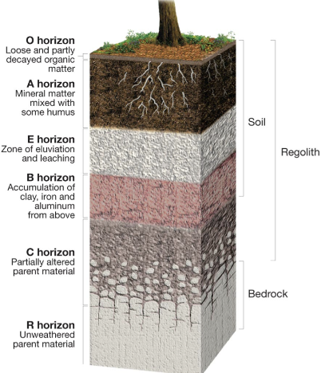
Soil Horizons:
Buffering Capacity:
When soil develops it ends up forming different types of layers containing different elements
These layers are in a straight line horizontally
- Soil absorbs filters and stores water.
It has different matter like air, small organisms and micro organisms that when decomposed create nutrients for the soil.
The dark soils are on top because they contain the most organic matter like water ( which plants roots are in to make there own food)
The lighter the colour the more far down it is.
-The pH scale is from 0-very acidic to 14-very alkaline. Plants usually prefer a pH of 6 to 7.
The exception are for plants like conifers that like a more acidic pH
THE BUFFERING capacity of a soil is it’s ability to resist changes in pH when acids or bases are added. Clay soils have good buffering capacity.
Conditions for fertile Soil:
Plenty amount of minerals like water and dissolved nutrients
Decent amount of moisture
Good soil pH, if its too acidic or alkaline it will prevent the transportation of nutrients to the roots

Slide 2
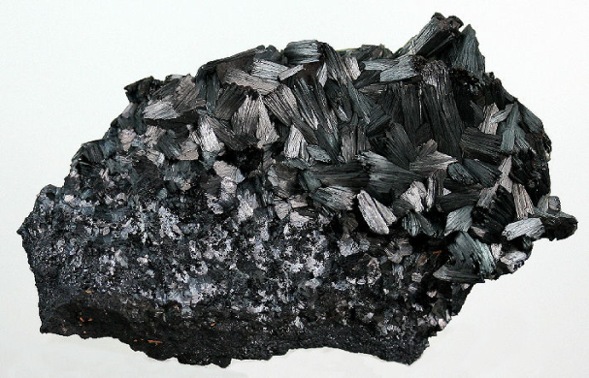
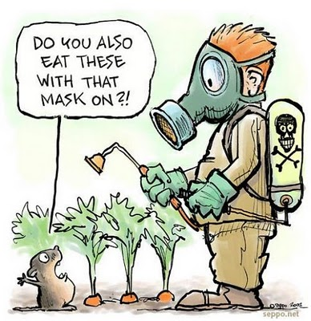
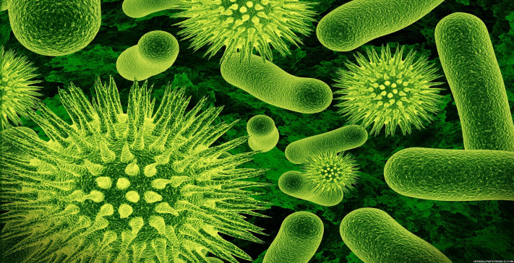
Major Contaminants:
Something that makes a place or a substance (such as water, air, or food) no longer suitable for use. ← Contaminant.
Contaminants fall into four main groups depended on their description.
In organic contaminants: Lead, arsenic, mercury, nitrogen oxides, phosphorus.
Organic contaminants: Insecticides, pesticides, polychlorinated biphenyls and benzene.
Microbial contaminants: Viruses and harmful bacteria.
Radioactive contaminants: Uranium, plutonium and radon.
When a contaminant harms an organism that contaminant is there fore toxic towards that organism
The toxicity depends on the following three factors:
Concentration: the more the concentration the higher the risk. For example if there is more concentration of lead in drinking water then it is more harmful towards humans
The organism contacted: some contaminants may be harmful towards some organisms but towards other they are somehow immune towards the contaminant.
Length of exposure: The longer the contaminant is in contact with the organism the greater the risk of toxicity. For example the longer the people smoke the worst it is for them.

Slide 3
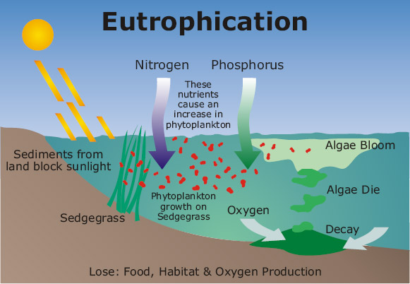
Eutrophication:
Nitrogen and Phosphorus fertilizers from farmer’s fields or septic systems can enter water bodies.
This will cause excessive algae growth. Eutrophication occurs when dead algae sinks to the bottom of a lake and is later eaten by bacteria that consumes a massive amount of oxygen, resulting in the loss of oxygen in the water. This results in fish dying and the quality of the water decreasing.

Slide 4
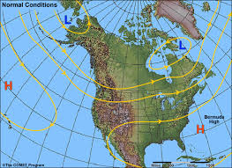
Prevailing winds:
Winds that blow mainly from one direction during a given period ←Prevailing winds.
They consist of:
Easterlies: Move between the pole and the 60th parallel
Westerlies: Blow in the middle latitudes, between the 60th and 90th parallels
Trade winds: are easterly winds moving between the 30th parallel and the equator.
Prevailing winds lay an important role in meteorological phenomena's, that’s why in Quebec and North America in general prevailing winds are easterlies meaning they move from west to east.

Slide 5
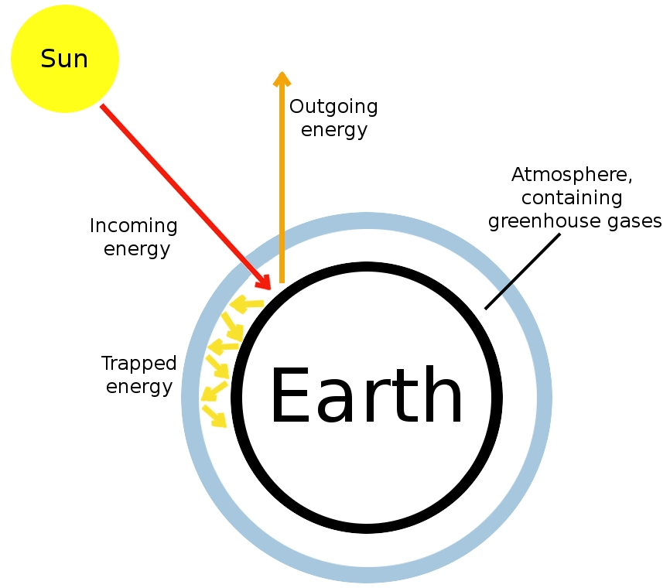
Greenhouse effect:
How it works:
Green house gases include the following gases, water vapour (H20),carbon dioxide(CO2), methane (CH4) and nitrous oxide (N2O).
With all this gases in our atmosphere they act like a blanket for our earth keeping some of the earths energy that we collect from the sun ← Green house gas effect.
Without that the earths temperature would be -18 degrees meaning that it would be too cold for any living organisms to survive including humans.
A greater amount of the suns rays that reach the earths surface are absorbed into the ground.
When its heated the ground beams infrared rays(electromagnetic radiation) into the atmosphere. By doing so some of the rays are lost in space.
The green house gases trap some of the infrared rays and send them back to earth so that it can heat the surface.
Carbon Dioxides Role:
Carbon dioxide mainly comes from volcanic eruption, forest fires and cellular respiration. These emission counteract by the consumption CO2 by growing plants through cellular respiration and the ability of oceans capturing large amounts of this gas. This balance kept the temperature here on earth rather stable.
However that not the case today we are releasing more tonnes of carbon dioxide than ever before and that has a huge impact on the earths greenhouse effect.
When carbon dioxide is collected the atmosphere it traps a lot of infrared rays emitted by the earth. So that means the atmosphere of earth is heating up. This can result in increased sea levels, droughts and changes in weather patters and loss of animal habitats.

Slide 6
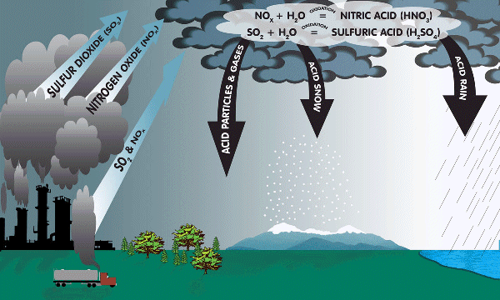
Acid Rain:
Ozone hole:
The main factors for acid rain are the following gases, sulphur dioxide (SO2) and nitrogen oxides (NOx).
As we already know pollution has a massive affect on acid rain because of the gases that are emitted such as mercury (Hg), arsenic (As) and lead (Pb) which mainly come from coal combustion.
Since wind is a concept wind can carry large amounts of polluted air thousands of kilometres way.
Mainly comes from the gases that destroy the ozone layer causing a somewhat of a hole.
Every time even a small amount of the ozone layer is lost, more ultraviolet light from the sun can reach the Earth.
The environment will also be negatively affected by ozone depletion. The life cycles of plants will change, disrupting the food chain. Effects on animals will also be severe.
Scientist revealed that chlorofluorocarbons (CFC’s) used in refrigeration systems and aerosol cans are the cause of destroying the ozone layer.
The gases that occur in the ozone layer are (O3)
When an ultraviolet ray is engaged by a CFC molecule the CFC releases a chlorine (Cl) atom. When the chlorine atom bonds with the ozone molecule it destroys it. Just like how it destroys the ozone layer.
Smog:
Smog generally occurs in the lower part of the atmosphere.
Smog is a combination of airborne particulate matter, like soot, and invisible toxic gases including ozone (O3), carbon monoxide (CO), sulfur dioxide (SO2), and carcinogens
It is a thick mixture of fog, smoke and atmospheric pollutants ← Smog.
Gasoline escaping from cars play a huge role in the creation of smog.

Slide 7
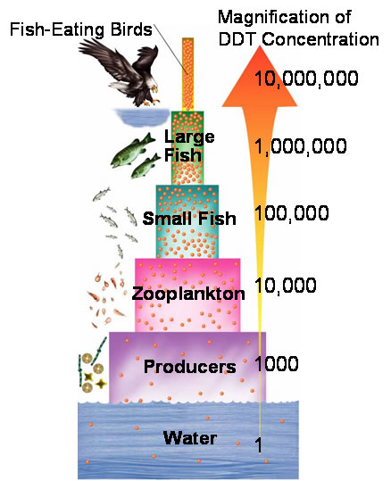
Toxicity Threshold:
Bioaccumulation vs Bioconcentraion
In order to determine when a contaminant is toxic towards an organism scientists asses it based on its toxicity threshold.
The threshold is a small amount of the contaminant that produces a harmful affect on the organism
The level of concentration above which a contaminant causes one or more hazardous effects in an organism ← Toxicity Threshold
So it basically means that there is a certain amount of toxins that is not harmful towards and organism and then if it exceeds that amount then it is harmful.
To compare the toxicity of contaminants scientists can determine their Lethal Doses, that value indicates the amount of contaminant necessary in a single dose to cause death of an organism.
When a certain contaminant like heavy metals called PCB’s and DDT’s is in the body of an organism it can not be eliminated. So the organism has no choice but to live with it, so it accumulates into their tissues (and later causes death). ← Bioaccumulation
In a food chain the higher trophic levels feed on the lower ones. So when Bioaccumulation occurs the organism will be full of that contaminant that the consumers of that organism will later hold that contaminant as well. However the higher up the organism the more contaminants it holds ← Bioconcentration . So be careful of what you eat for example many fish hold mercury in their system due to pollution in the Ocean.
In the end bioaccumulation is the base for Bioconcentration because with out the contamination of lower trophic levels and the consumption of it bioconcentration would not exist.

